Slide 1
Crowd Canvass Sprint Update
Shayne Burns,
Ramzi Carter,
Wylie Frydrychowicz,
Max Rothweiler, &
Hannibal Santiago

Slide 2
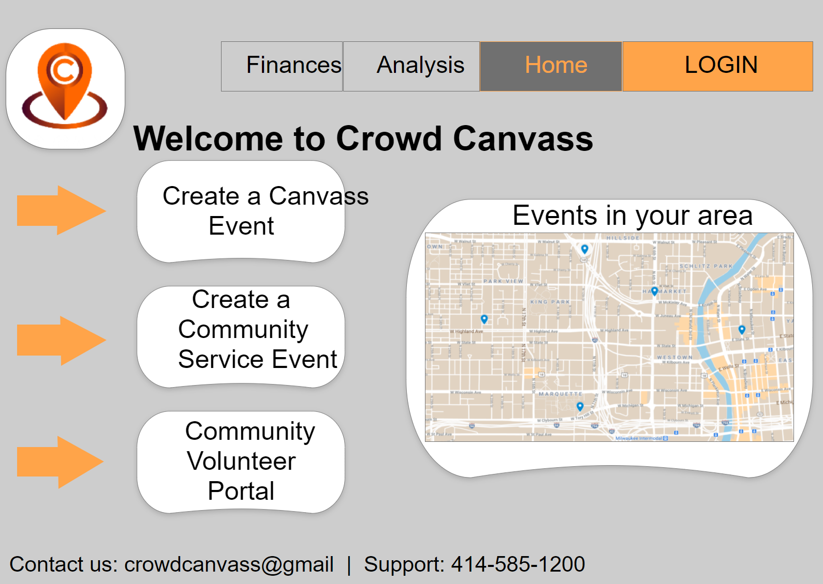
Past 2 Weeks Sprint
Interlink all web pages and ensure seamless navigation for users
Have a well-functioning web application that is intuitive and user-friendly

Slide 3

Goals for Next two Weeks
Research and select the most optimal database
Set up the database and connect it to our web application

Slide 4

Live Demo
Web Application Link:
https://crowdcanvass.web.app/

